Slide 1



Slide 2


WHY PURE
HEART - VISION - BUSINESS - MISSION

Slide 3


BUILDING THE NEXT BILLION DOLLAR BRAND TOGETHER

Slide 4
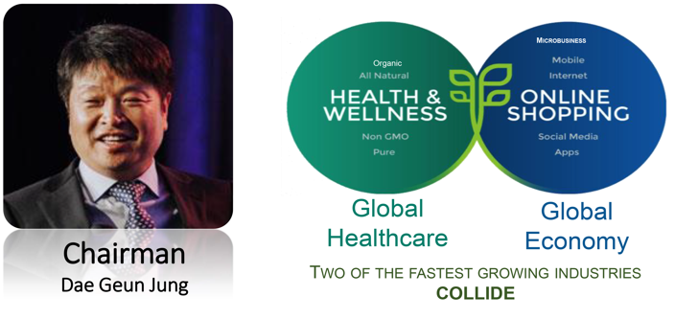
COMPANY HIGHLIGHT - FOUNDER

Slide 5

FACTS ABOUT PURE
12 Successful Years in Business
Frisco, Texas – USA
Global Presence – 12 countries
Over 65 Product Lines
Hi-ACT Principles
~ $100 Million Annual Sales

Slide 6
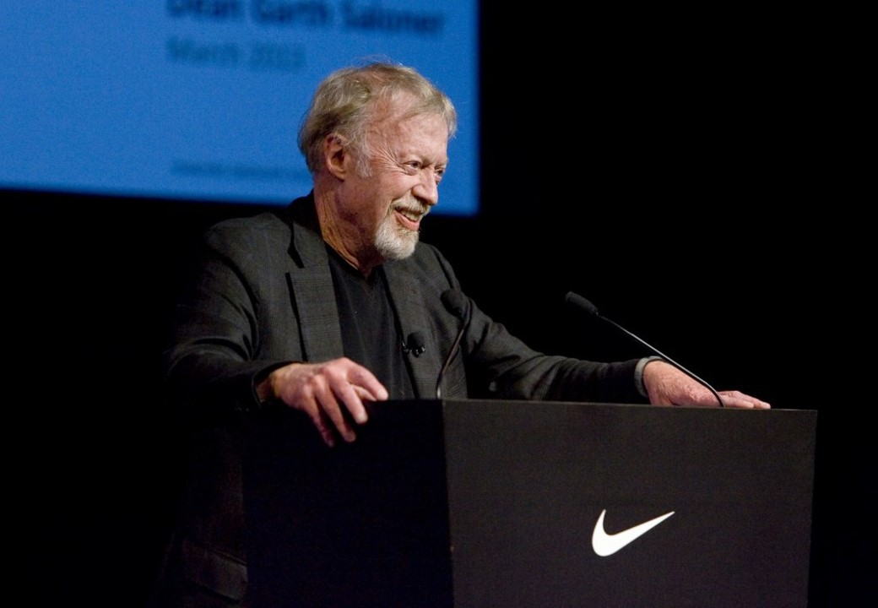

Phil Knight
Founder of Nike
PURE Investor
21st RICHEST MAN IN THE WORLD
(as at October 2019)
Estimated Net-worth: US$37.6 billion
Notes:
6

Slide 7
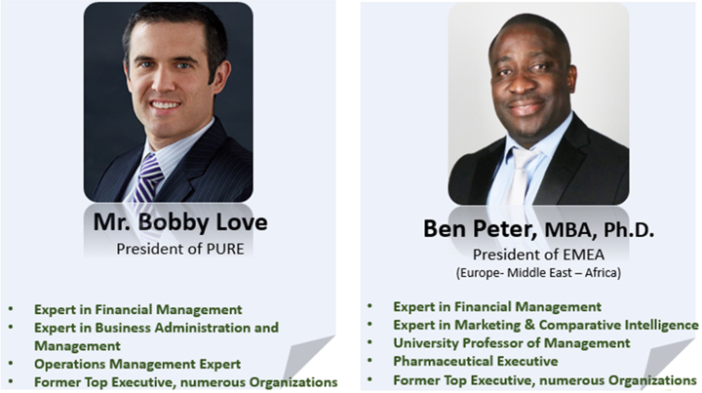
CORPORATE EXECUTIVE

Slide 8
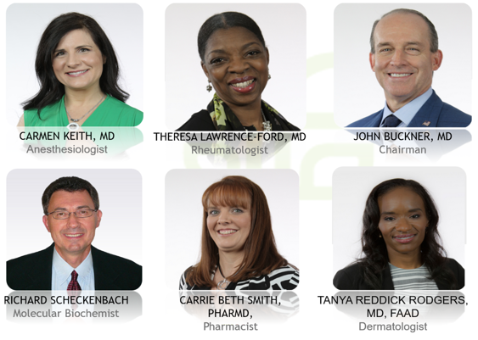
WELLNESS ADVISORY BOARD

Slide 9
PRODUCT LINE
PURE offers over 65 innovative and medical breakthrough products ranging from:
Supplement and Nutritional Support Products
Energy Performance Products
Sport Recovery Products
Skincare and Beauty Products
Liquid Supplement and Coffee Products
Sexual Health Products

Slide 10


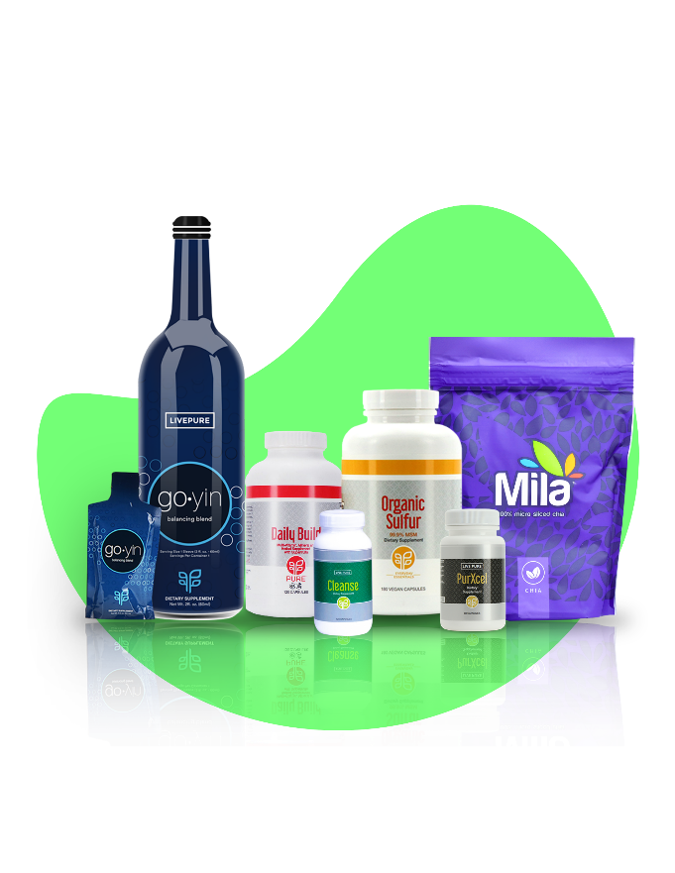

Slide 11
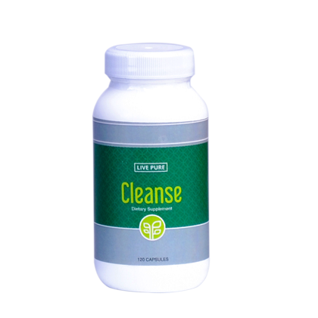
CLEANSE
2020
PHYSICIAN’S
DESK
REFERENCE
PDR.NET
CLEANSE

Slide 12
CLEANSE
Natural Detoxification for the Body
Cleanse has been specially formulated to help
to remove harmful toxins from the body.
The active ingredient :
Cascara Sagrada (an aged, dried extract of Rhamnus purshiana bark ) promotes effective cleansing of the entire body system.

Slide 13
CLEANSE
Cleanses 7 Elimination Pathways
Liver
Lungs
Blood
Skin
Colon
Kidneys
Lymphatic System

Slide 14
BENEFITS OF CLEANSE
It support Digestive Health
It promotes colon Health – Feel clean from the inside
It helps to manage weight loss
It helps to maintain normal intestinal micro flora
It detoxifies the body by flushing out the free radicals Reawakens dead cells and lots more

Slide 15

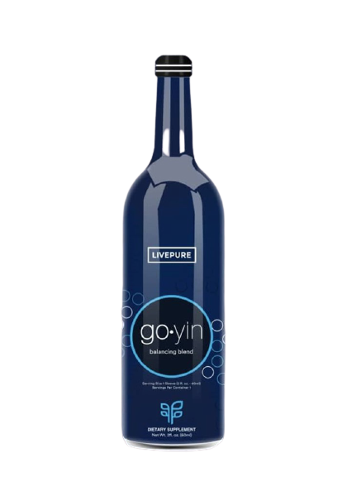

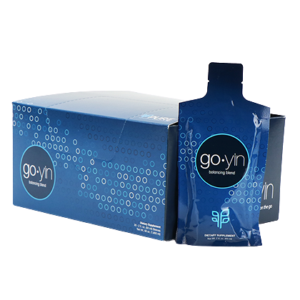
GOYIN
2020
PHYSICIAN’S
DESK
REFERENCE
PDR.NET

Slide 16
GOYIN
Based on Traditional Chinese Medicine (TCM), go•yin uses a verified formula to bring balance to your body and life, allowing the body to heal itself and function at its peak levels
For over 5,000 years, TCM practitioners have tested and refined the art of balancing the body as a way of enhancing overall health and well-being.*
go•yin unifies the analytical benefits of Western science with Eastern knowledge of proper ratios and blending to create a perfect balancing blend.

Slide 17
BENEFITS OF GOYIN
Supports Healthy Energy
Enhances Mood
Supports a Balanced Body
Increases Vigor
Reduces Tension, Sadness and Fatigue
Delivers Antioxidant Protection
High in vitamins B₆ and B₁₂
Non-GMO
Vegan

Slide 18
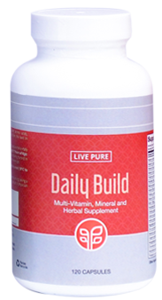
DAILY BUILD
2020
PHYSICIAN’S
DESK
REFERENCE
PDR.NET
DAILY
BUILD

Slide 19
DAILY BUILD
An all-inclusive powerful supplement that is more than just a multi-vitamin
Over 240 ingredients
Balance your diet with the most important vitamins and the highest quality complexes that promotes overall health and maintain optimal balance of vitamins and minerals.

Slide 20
DAILY BUILD
240 PREMIUM NUTRACEUTICALS
Naturally occurring Phyto-nutrients
Fruits and Vegetables
Proprietary Herbs
Beneficial Fibers
Vitamins
Minerals from Whole Foods
Essential Fatty Acids
Amino Acids
Organic Plant Digestive Enzymes

Slide 21
BENEFITS OF DAILY BUILD
General Health and Wellness
Improved Immune System
Supports Healthy Bones
Supports Cardiovascular System
Support Liver and Digestive Systems
Total Systems detoxification of inter-cellular metabolic wastes
Anti Aging System, Longevity and Vibrant Life.
Repairs Muscle, Tissues, Joints, Ligaments and Tendons
Increased Energy, power and mental Acuity
Maintains Nerve Function
Superior Antioxidant
Reduces Free Radical Damage

Slide 22
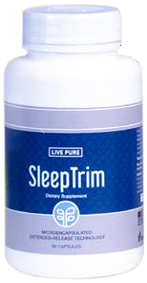
SLEEPTRIM
SLEEP TRIM

Slide 23
SLEEPTRIM
Experience a more restful night’s sleep naturally while supporting your body’s ability to manage weight.
This microencapsulated, extended-release technology slowly delivers a blend of melatonin and blend of capsaicin and red pepper extract to help the body burn calories while you sleep.

Slide 24
BENEFITS OF SLEEPTRIM
It helps with quality sleep.
It helps the body to relax mentally and physically
It helps the body to burn calories naturally during sleep
It delivers melatonin in stages so you can fall asleep and wake up refreshed
It helps the body maintain and manage weight

Slide 25
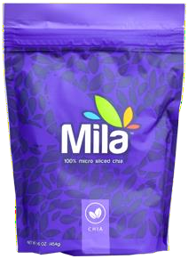
MILA
MILA

Slide 26
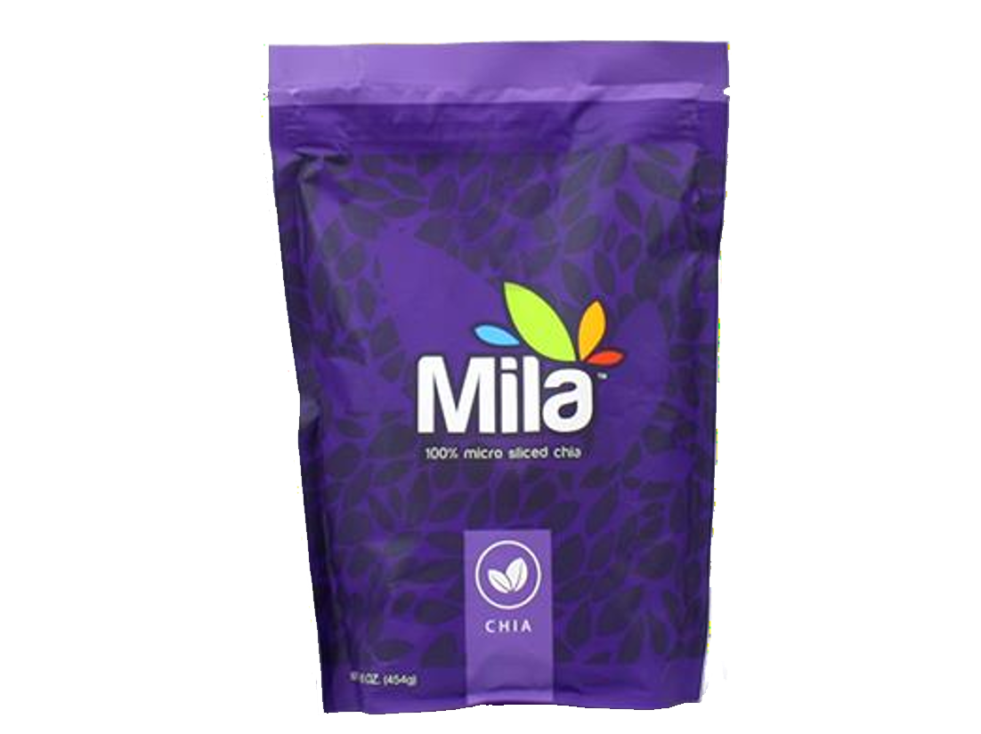
MILA
A super food that is the best source of plant based protein and fiber.
Mila uses wide ranges of Chia species to provide enormous nutrients.
Gluten-free, Trans-fat free, Sugar free

Slide 27
BENEFITS OF MILA
A natural source of antioxidants and phytonutrients
Provides calcium, Magnesium, Phosphorous for
bone health.
Contains Alpha-linolenic Acid(ALA), Omega 3 fatty acid for normal growth and development of brain function
High in fiber - the insoluble fiber in MILA helps relief occasional constipation and promote satiety
Easy to consume- mix with your favourite dishes, yoghurt, salad, smoothies, pap drink, food drink beverages, soup etc

Slide 28
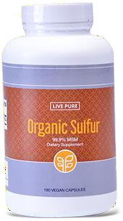
ORGANIC SULFUR
ORGANIC SULFUR

Slide 29
ORGANIC SULFUR
Replenish your body with the highest level of Organic Sulfur
Our Organic Sulfur consists of 99.9% pure distilled
Methylsulfonylmethane (MSM)
No added fillers and binders No artificial ingredients
Non-GMO, gluten-free, dairy-free, and vegan

Slide 30
BENEFITS OF ORGANIC SULFUR
It helps produce collagen(main component of connective tissue)
It supports protein of tendons and supports cartilage
It improves flexibility and mobility by promoting joint function and health.
It promotes healthy bones, cavity and helps the connective
tissues
It helps promote healthy hair gland and nails.
It reduces wrinkles and dryness
It help maintain natural glowing skin and fight against skin conditions such as acne, pimples, psoriasis, vitiligo, blemishes, scare etc.

Slide 31
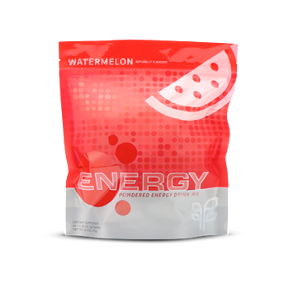
ENERGY (WATERMELON FLAVOR)
ENERGY
Watermelon

Slide 32
ENERGY (WATERMELON FLAVOR)
A powerful quick energy booster
Looking for a way to clear the morning fog, energize your daily workout, or avoid the mid-afternoon slump? ENERGY is for you

Slide 33
ENERGY (WATERMELON FLAVOR)
Natural sources of caffeine
Blend of antioxidants and botanicals
No artificial coloring or sweeteners
No preservatives
Gluten-Free, Non-GMO

Slide 34
BENEFITS OF ENERGY)
A single serving helps stimulate alertness, ease fatigue, and fuel your focus.
High in B-vitamins, such as thiamin, riboflavin, B6 and B12, which are useful for converting food into fuel
Stimulates alertness
Enhance cognitive performance
Ease fatigue
Promote wakefulness

Slide 35
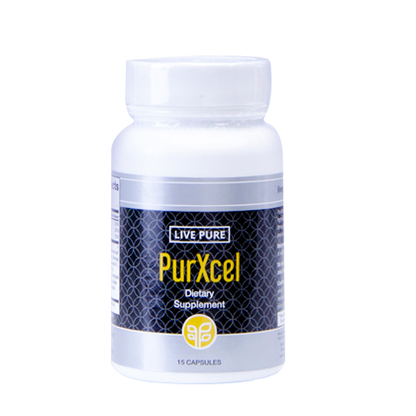

PURXCEL
2020
PHYSICIAN’S
DESK
REFERENCE
PDR.NET
PURXCEL

Slide 36
PURXCEL
PurXcel Tri-active Technology delivers clinically effective:
Bioavailable Glutathione
Superoxide Dismutase (SOD)
Aloe Acemannan
With a proprietary blend of 15 complimentary ingredients designed to help cleanse, balance, and build the body at the cellular level

Slide 37
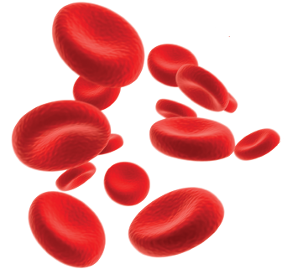
WHY GLUTATHIONE?
The human body contains trillions of cells
We create 40 billion new cells daily
Every single cell needs glutathione to survive!
It is one of the body’s most powerful antioxidant.

Slide 38
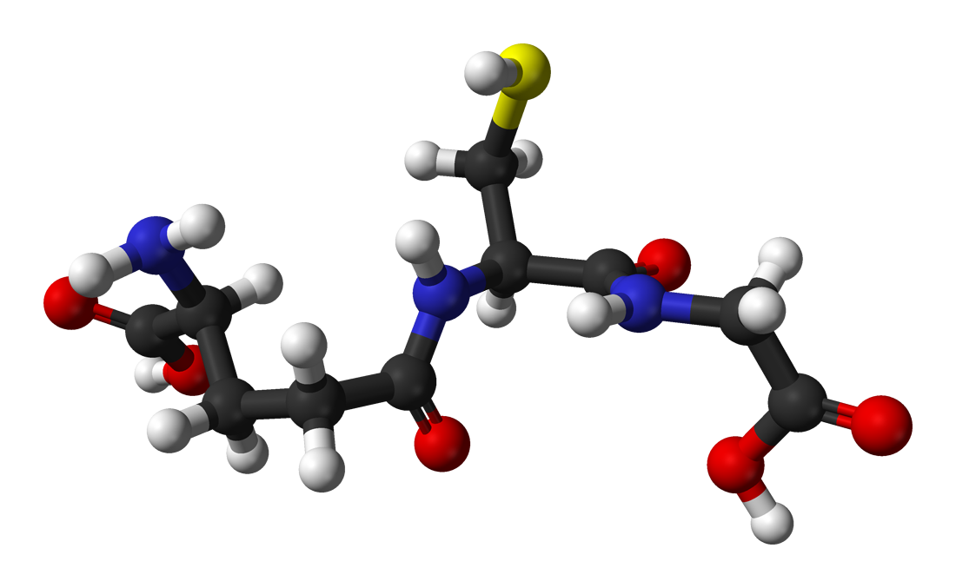
BENEFITS OF GLUTATHIONE
Strengthens the Immune System
Improves Mental Focus, Acuity & clarity
Reduces the harmful effects of stress
Optimize the body’s Energy Level
Detoxifies the body organs and cells
of toxins
Supports better Rest and sleep
Makes one look Younger and skin healthier
Enhances Athletic Ability and Performance
Enhanced Sexual Health and Libido

Slide 39
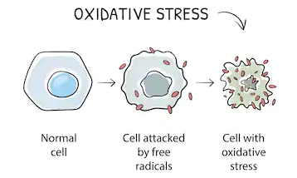
PROBLEM/DEPLETION OF CELLULAR GLUTATHIONE
As we get older, the food we eat, the air we breath and so many things create FREE RADICALS that damage and degrade our cells
It happens through a process called oxidative stress

Slide 40
INCREASE IN OXIDATIVE STRESS

Slide 41
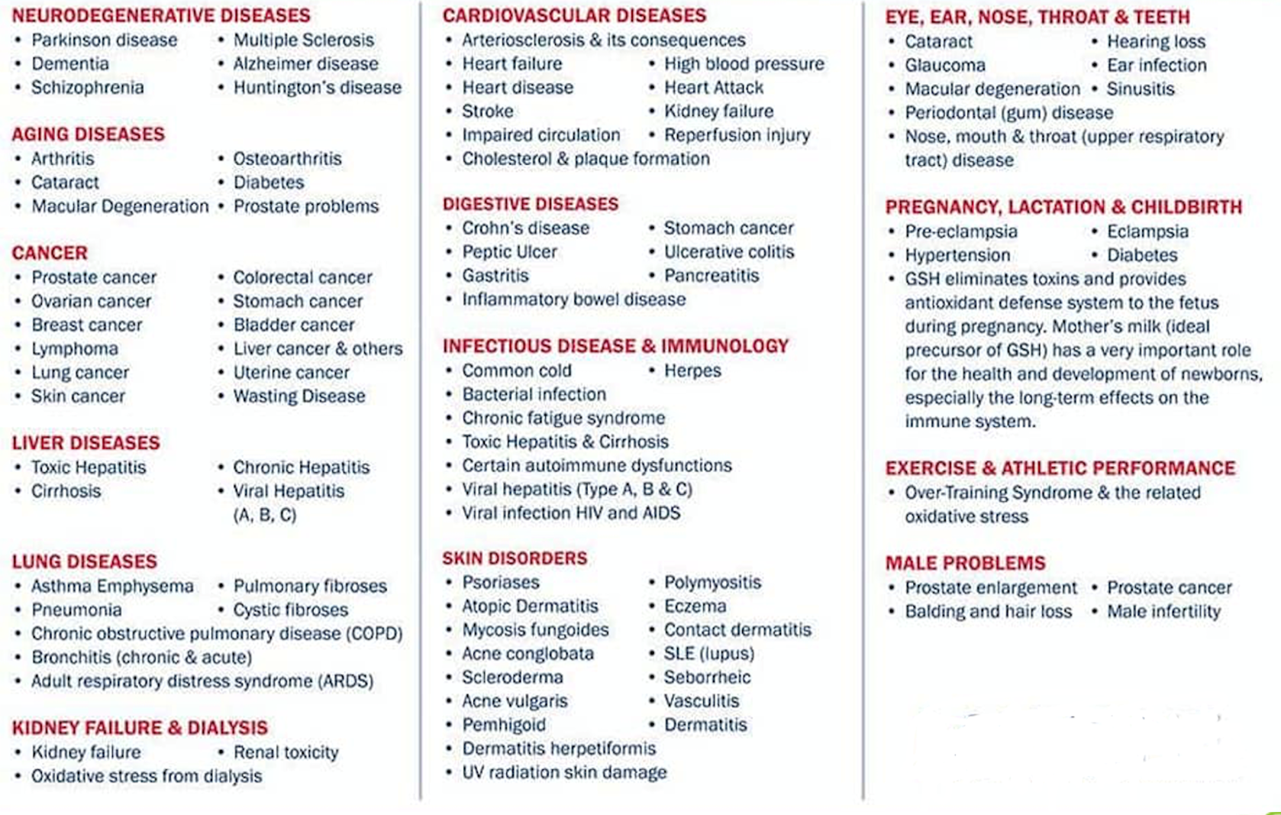
DISEASES ASSOCIATED WITH LOW GLUTATHIONE

Slide 42
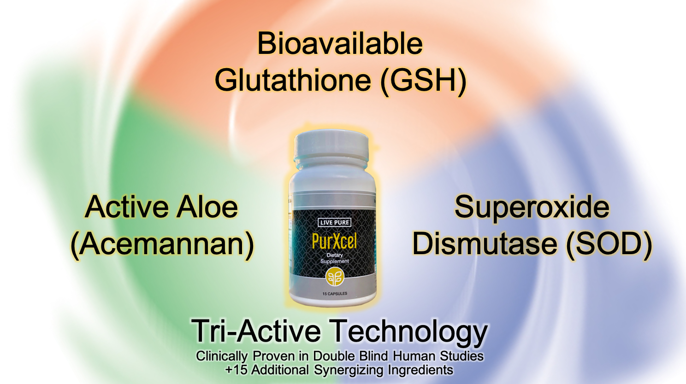
BEYOND GLUTATHIONE

Slide 43
SUPEROXIDE DISMUTASE (SOD)
Superoxide dismutase (SOD) is a primary antioxidant enzymes.
It is a very important antioxidant defense against oxidative stress in the body.
Within our cells, the superoxide dismutases (SODs) constitute the first line of defense against Reactive Oxygen Species (ROS) and Free Radicals.

Slide 44
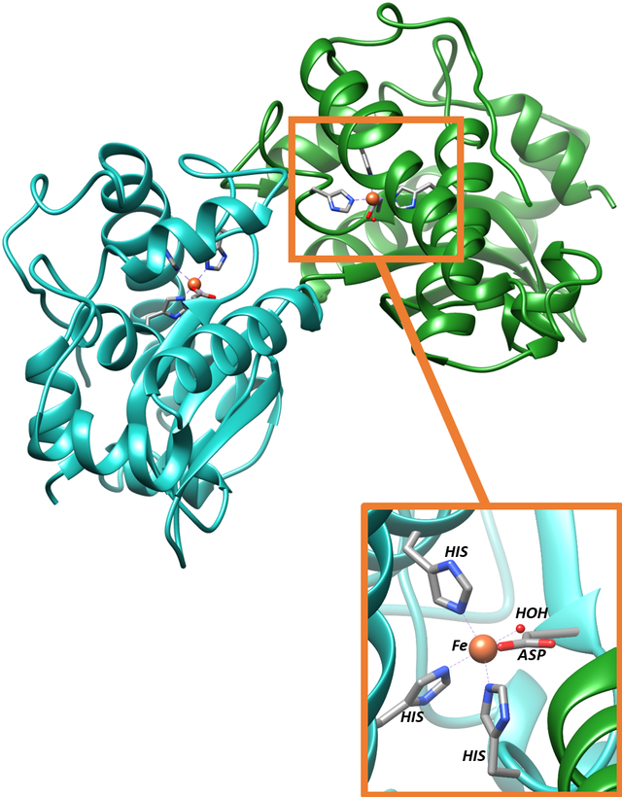
BENEFITS OF SUPER OXIDE DISMUTASE (SOD)
Enhances Joint Health
Enhances Sexual Health
Relieves the body of Physical Pains
Improves Physical Recovery and Wellbeing
Reduces Acne
Helps with UV Protection
Enhances Cellulite Reduction
Enhanced Eye Health

Slide 45

ALOE ACEMANNAN
Acemannan is the main active ingredient and bioactive polysaccharides in the Aloe Vera Plant.
Aloe Acemannan has immuno-stimulant, antiviral, antineoplastic (tumor), and gastrointestinal properties.

Slide 46
BENEFITS OF ACEMANNAN
Modulates the immune system (immuno-regulation)
Accelerates the healing of wounds and burns
Accelerates the healing of ulcers and postsurgical incisions
Has Antineoplastic (tumor) and antiviral effects
Has anti-cancer and an anti-oxidant effects
Promotes bone proliferation
Improves neuro -protection
Promotes intestinal health

Slide 47
COMPLIMENTARY INGREDIENTS
MIKE THISTLE | Milk thistle is sometimes used as a natural treatment for liver problems Lowers cholesterol levels anti-inflammatory and antioxidant
ALPHA LIPOIC ACID | lower blood sugar levels reduced inflammation slowed skin aging improved nerve function
TUMERIC EXTRACT | Has potential to prevent heart disease, Alzheimer's and cancer
MORINGA OLEIFERA LEAF | Lowering of Blood Sugar Levels May Reduce Inflammation Lower Cholesterol
BIOPERINE BLACK PEPPER EXTRACT | Enhances bioavailability Enhances absorption of nutrients by at least 30%.
And Many other ingredients

Slide 48
PROVEN FACTS ABOUT PURXCEL INGREDIENT
Clinically proven human studies- double blind placebo studies
Key Human Studies showed a 325% increase in overall cellular Glutathione Levels
Contains proprietary blend of 15 complimentary ingredients designed to help cleanse, balance, and build the body through glutathione and superoxide dismutase support and production
Over 110 American company trust our Glutathione ingredient
The trusted glutathione ingredient in the world

Slide 49
PURXCEL GLUTATHIONE SUPPORT STUDIES
AUTHORS | STUDIES | RESULTS/FINDINGS
Wu G Fang YZ Yang S Lupton JR Turner ND | Glutathione metabolism and its implications for health | Glutathione plays important roles in antioxidant defense, nutrient metabolism, and regulation of cellular events (including gene expression, DNA and protein synthesis, cell proliferation and apoptosis, signal transduction, cytokine production and immune response, and protein glutathionylation). Glutathione deficiency contributes to oxidative stress, which plays a key role in aging and the pathogenesis of many diseases (including kwashiorkor, seizure, Alzheimer's disease, Parkinson's disease, liver disease, cystic fibrosis, sickle cell anemia, HIV, AIDS, cancer, heart attack, stroke, and diabetes).
Sinee Weschawalit Siriwan Thongthip Phanupong Phutrakool Pravit Asawanonda | Glutathione and its antiaging and antimelanogenic effects | We showed that oral glutathione, 250 mg/d, in both reduced and oxidized forms effectively influences skin properties. Overall, glutathione in both forms are well tolerated.
Over 148,913 clinical studies on PUBMED

Slide 50
PURXCEL SOD SUPPORT STUDIES
AUTHORS | STUDIES | RESULTS/FINDINGS
Milesi MA Lacan D Brosse H Desor D Notin C | Effect of an oral supplementation with a proprietary melon juice concentrate (Extramel) on stress and fatigue in healthy people: a pilot, double-blind, placebo-controlled clinical trial. | The supplementation with the proprietary melon juice concentrate bringing 140 IU SOD/day significantly improved signs and symptoms of stress and fatigue linked to performance, physical (pain, sleep troubles), cognitive (concentration, weariness, sleep troubles) or behavioural (attitude, irritability, difficulty of contact) compared to the placebo. In the same way, quality of life and perceived stress were significantly improved with SOD supplementation.
H. Younus | Therapeutic potentials of superoxide dismutase | The present review describes the therapeutic effects of SOD in various physiological and pathological conditions such as cancer, inflammatory diseases, cystic fibrosis, ischemia, aging, rheumatoid arthritis, neurodegenerative diseases, and diabetes.
Over 81,876 clinical studies on PUBMED

Slide 51
PURXCEL ACEMANNAN SUPPORT STUDIES
AUTHORS | STUDIES | RESULTS/FINDINGS
Sierra-García GD Castro-Ríos R, González-Horta A, Lara-Arias J, Chávez-Montes A | Acemannan, an extracted polysaccharide from Aloe vera: A literature review. | Acemannan has various medicinal properties like osteogenic, anti-inflammatory, and antibacterial, which accelerate healing of lesions. Also, acemannan is known to have antiviral and antitumor activities in vivo through activation of immune responses. It was concluded that Aloe vera has immense potential as a therapeutic agent.
Liu C, Cui Y, Pi F, Cheng Y, Guo Y, Qian H. | Extraction, Purification, Structural Characteristics, Biological Activities and Pharmacological Applications of Acemannan, a Polysaccharide from Aloe vera: A Review. | Acemannan, considered one of the main bioactive polysaccharides of Aloe vera, possesses immunoregulation, anti-cancer, anti-oxidation, wound healing and bone proliferation promotion, neuroprotection, and intestinal health promotion activities, among others.

Slide 52

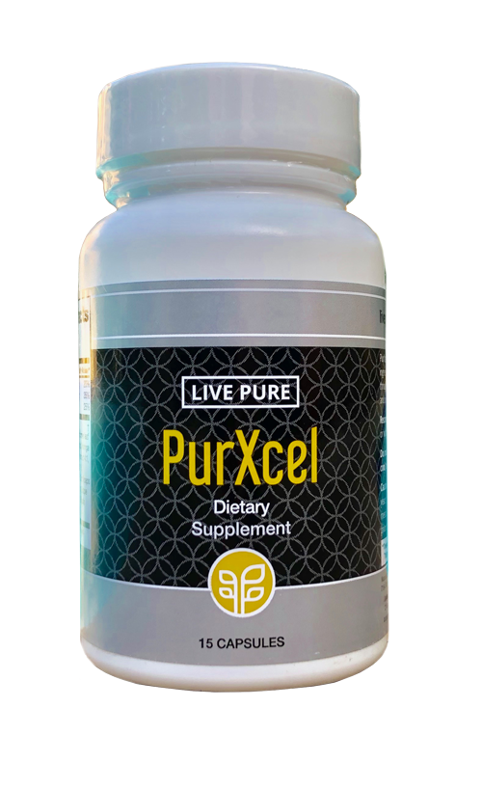
WHAT COULD PURXCEL MEAN FOR ME?
Weight Management
Pain Relief
Sleep Quality
Energy
Fertility
UV Protection
Cognitive Ability
Anti-aging
Cellulite Reduction
Physical Performance
Immunity
Lowers Cholesterol Levels
Anti-inflammatory
Primary Antioxidant
Lowering of Blood Sugar Levels
Bone Proliferation
Antineoplastic
Improves Neuro-Protection
Promotes Intestinal Health
Sexual Performance & Fertility
and lots more

Slide 53



PRODUCT TESTIMONIALS
2020
PHYSICIAN’S
DESK
REFERENCE
PDR.NET

Slide 54
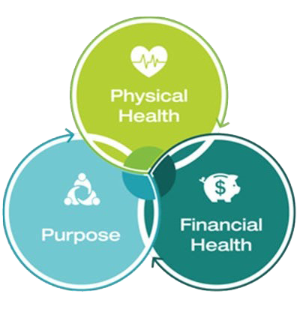
GREAT PRODUCTS = GREAT BUSINESS OPPORTUNITY
PURE BUSINESS OFFERS…
A unique Business opportunity for everyone
The world’s most rewarding compensation plan
Easy to understand

Slide 55

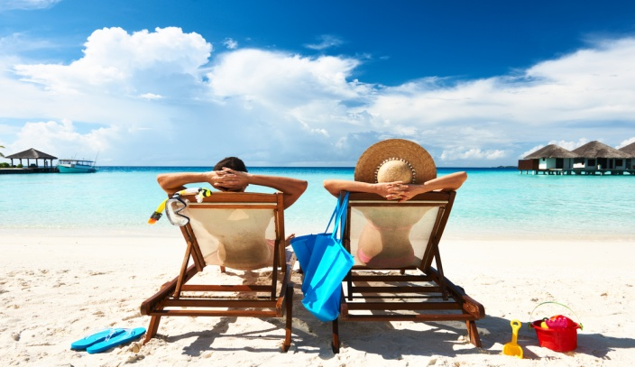
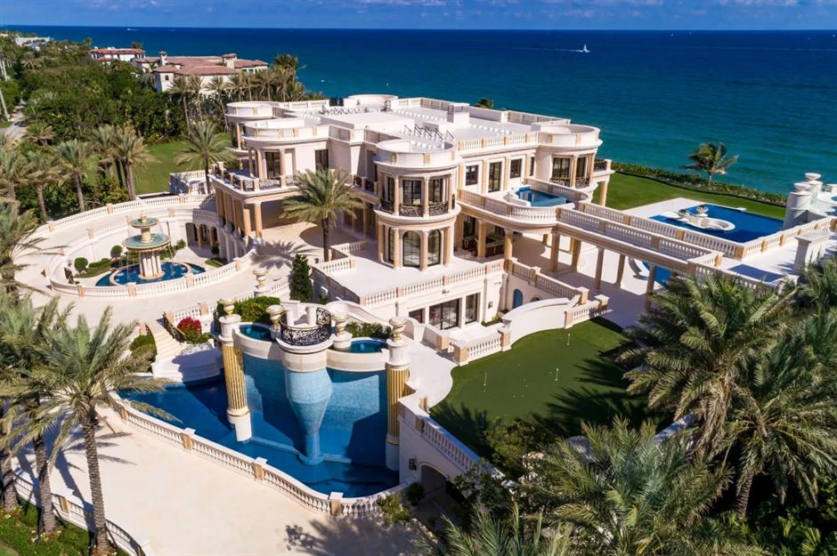

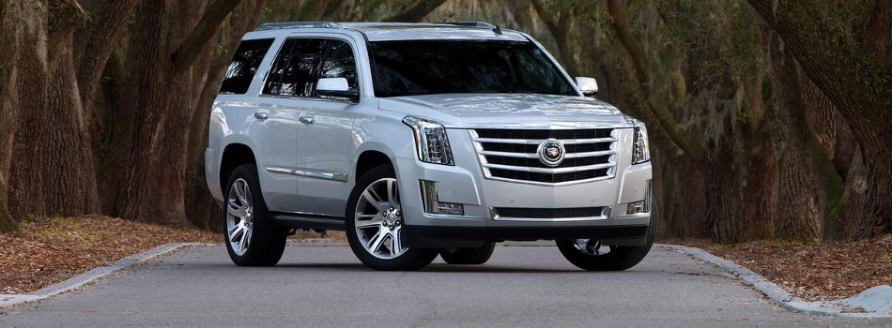


PURE PROSPERITY PLAN
Build the life of your dreams

Slide 56







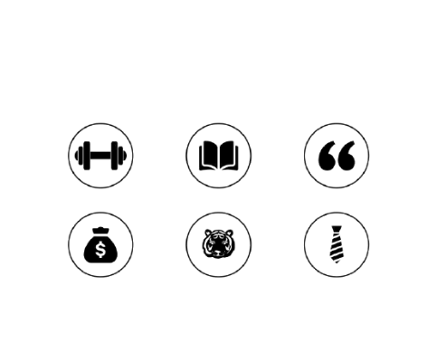



TEN WAYS TO EARN IN PURE
Retail Bonus
Pack Bonus
(Paid Weekly)
Sponsor Bonus
(Paid Weekly)
Team Bonus
(Paid Weekly)
Generational Matching Bonus
(Paid Weekly)
Rank Achievement Bonus
(paid 1 time, + in addition to all earned commissions)
Lifestyle Bonus (paid monthly)
Leadership Bonus
(paid monthly)
Luxury Incentive Trips
Luxury Car Programme

Slide 57
EARNING MATRIX
Starting
point
RETAIL INCOME
Stability
point
MID INCOME
Peak income
point
RESIDUAL INCOME
(Product Sales)
(Sponsor Bonus, Pack Bonus etc.)
(Generational Bonus, Shares etc.)

Slide 58
RETAIL PROFIT
1
Buy Product Packs or any product at wholesale and sell at a retail price.
Retail Price – Wholesale Price = Retail Profit

Slide 59






STARTUP PACK
PACK VOLUME | NIGERIA | GHANA | SOUTH AFRICA | KENYA | CAMEROON | U.S
50 PV | ₦ 51,500 | GHC 540 | ZAR 2,200 | KES14,190 | CFA65,880 | $129 USD
100 PV | ₦ 77,000 | GHC 810 | ZAR 3,200 | KES20,680 | CFA98,820 | $183 USD
250 PV | ₦212,000 | GHC 2,230 | ZAR 8,700 | KES56,210 | CFA272,060 | $467 USD
500 PV | ₦411,000 | GHC 4,325 | ZAR 16,900 | KES109,340 | CFA527,650 | $886 USD
$1= ₦475, 5GHC, ZAR 17, KES110, CFA610

Slide 60
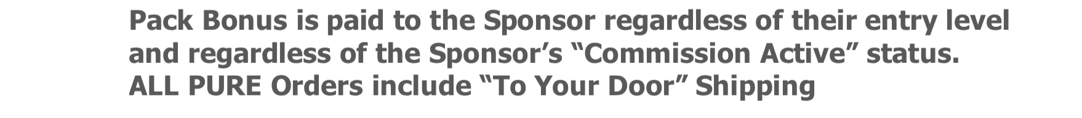
PACK BONUS
2
PV | COMMISSION ACTIVE | PRODUCT UNITS | PACK BONUS
50 | 4 Weeks | 2- 4 | $15
100 | 8 Weeks | 4- 8 | $30
250 | 12 Weeks | 10 | $60
500 | 16 Weeks | 20 | $100
PACK BONUS IS PAID WEEKLY

Slide 61
SPONSOR BONUS
3
Sponsor Bonus is paid weekly.
When you enroll a new PURE IBO, you will receive 10% of their
product order PV during their first 90 days.
PV | COMMISSION ACTIVE | PRODUCT UNITS | SPONSOR BONUS
50 | 4 Weeks | 2- 4 | $5
100 | 8 Weeks | 4- 8 | $10
250 | 12 Weeks | 10 | $25
500 | 16 Weeks | 20 | $50
SPONSOR BONUS IS PAID WEEKLY

Slide 62
TOTAL IMMEDIATE BONUS
When you enroll a new PURE IBO, you receive this total Bonus.
PV | COMMISSION ACTIVE | PRODUCT UNITS | SPONSOR BONUS | PACK BONUS | TOTAL BONUS
50 | 4 Weeks | 2- 4 | $5 | $15 | $20
100 | 8 Weeks | 4- 8 | $10 | $30 | $40
250 | 12 Weeks | 10 | $25 | $60 | $85
500 | 16 Weeks | 20 | $50 | $100 | $150

Slide 63






TEAM BONUS (BINARY TREE)
4
Your personal Sales Organization is divided into two teams. Based on your Leadership Rank you may earn 10% of the Product Volume (PV) in your lesser team volume or “Pay” Team.
YOU
You earn
10%
in your LTV
BTV
Bigger
team
LTV
Lesser
team
(Pay Team)
David
Tony
John
Johny
To qualify for the TEAM Bonus, you must generate a minimum of 50PV every 4 weeks to be Commission Active, and enroll two people, one Commission Active person on your left and right.
TEAM BONUS IS PAID WEEKLY

Slide 64

TEAM BONUS (EXAMPLE)
Left (BTV) Right (LTV)
3300 PV 3000PV
(including spill over)
150PV
500PV
1000PV
100PV
1000PV
1500PV
50PV
500PV
= Spill over volume
500PV
LTV = Lesser Team Volume
BTV= Bigger Team Volume
1000PV
You would be paid 10% of your LTV E.g. 3,000 PV = $300

Slide 65
HOW TO ACHIEVE RANK
RANK | LTV | STV |  | Max STV/Leg | Weekly Potential Income Range**
IBO | Retail Bonus, Sponsor Bonus, and Pack Bonus
BRONZE | 500 PV |  | - | - | $50- $1,000
SILVER | 1500 PV |  | 2000 PV | 1500 PV | $150 - $1,000
GOLD | 3000 PV |  | 4000 PV | 3000 PV | $300- $1,500
PLATINUM | 5,000 PV |  | 7,000 PV | 5,000 PV | $500- $3,000
SAPPHIRE | 7,500 PV |  | 10,500 PV | 7,000 PV | $750 - $4,000
RUBY | 10,000 PV |  | 15, 000 PV | 10,000 PV | $1,000 - $6,000
EMERALD | 15,000 PV |  | 20,000 PV | 13,000 PV | $1,500 - $8,000
DIAMOND | 20,000 PV |  | 35,000 PV | 15,000 PV | $2,000 - $12,500
BLUE DIAMOND | 30,000 PV |  | 50,000 PV | 20,000 PV | $3,000 - $25,000
PRESIDENTIAL BLACK DIAMOND | 30,000 PV |  | 75,000 PV | 25,000 PV | $3,000 - UNLIMITED
CHAIRMAN BLACK DIAMOND | 30,000 PV |  | 150,000 PV | 50,000 PV | $3,000 - UNLIMITED
AMBASSADOR BLACK DIAMOND | 30,000 PV |  | 300,000 PV | 100,000 PV | $3,000 - UNLIMITED
CROWN DIAMOND | 30,000 PV |  | 500,000 PV | 125,000 PV | $3,000 - UNLIMITED
*Team + Generational

Slide 66
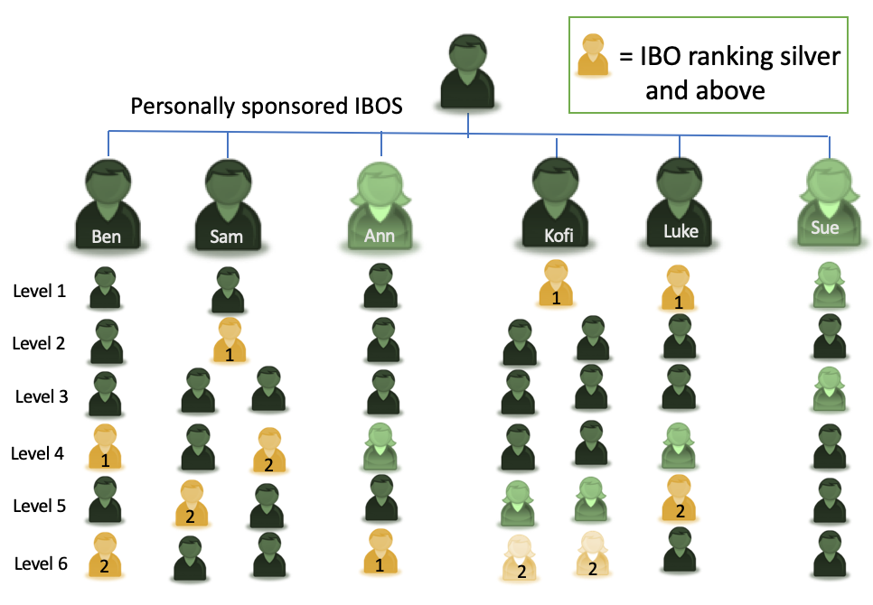
GENERATIONAL BONUS (SPONSOR TREE)
5
RANK/BONUS | Gen. 7% Match
GOLD | 1
PLATINUM | 2
SAPPHIRE | 3
RUBY | 4
EMERALD | 4
DIAMOND | 5
BLUE DIAMOND | 6
PRESIDENTIAL BLACK DIAMOND | 7
CHAIRMAN BLACK DIAMOND | 8
AMBASSADOR BLACK DIAMOND | 9
CROWN DIAMOND | 10
You
Based on your weekly Paid Rank you will receive a 7% MATCH on the Team Bonus of IBO’s in your Sponsor Team down through and including up to 10 Generations of Silver and above ranked leaders

Slide 67
RANK BONUS
6
CROWN DIAMOND
$250,000
AMBASSADOR
BLACK DIAMOND
$150,000
CHAIRMAN
BLACK DIAMOND
$37,514
PRESIDENTIAL
BLACK DIAMOND
$17,514
BLUE DIAMOND
$12,487
DIAMOND
$7,514
EMERALD
$3,757
RUBY
$2,500
SAPPHIRE
$1,252
PLATINUM
$1,000

Slide 68
2020 PURE RANK BONUS PROMOTION TERMS AND CONDITIONS
NO PURCHASE NECESSARY TO PARTICIPATE IN THE PURE RANK BONUS PROMOTION.
By participating in the PURE Rank Bonus Promotion, you accept and agree to be bound by these terms and conditions, which specifically include complying with all obligations set forth in your IBO Agreement.
The Promotion is valid for Independent Business Owners (IBOs) in the United States, Canada, Japan, Taiwan, Australia, New Zealand, Thailand and Africa only. IBOs must be active and in good standing at the time of earning and receiving the PURE Rank Bonus. ‘Active’ is defined as having 100PV or more (either personal product purchases or product sales to Retail and Preferred Customers or any combination thereof) every 28 days. PV (Product Volume) is the amount of volume assigned to each product. An IBO in good standing is compliant with the IBO Agreement, and has not received a compliance sanction, including but not limited to a sanction for probation, suspension or termination. Additionally, any notice for breaches of the Non-Solicitation, Non-Competition, Confidentiality or Proprietary Information provisions of the IBO Agreement will result in forfeiture of all PURE Rank bonuses and will disqualify the IBO from being awarded PURE Rank bonuses and participating in the PURE Rank Bonus Promotion in the future.
The Promotion qualification period begins on January 1, 2020, and ends on December 30, 2020.
Promotion participants can become qualified to earn the PURE Rank Bonus for their first time rank advancements, starting at Platinum Director and above. See the PURE Prosperity Compensation Plan published on the company website for rank qualification details.
PURE Rank Promotion Rules/Details include the Promotion qualification requirements and are published on the company website. From time to time, PURE may update, amend, add to, or modify the PURE Rank Bonus Promotion qualification requirements, in its sole discretion, without advance notice.
IBOs must abide by the PURE IBO Policies and Procedures. PURE reserves the right to disqualify an IBO if a policy violation, fraud or other conduct that compromises the integrity of the Promotion is identified, as determined by PURE in its sole discretion.
The bonus payout is awarded on a maximum of 5 bonus rank advancements during a commission period, i.e., no more than 5 bonus ranks can be skipped during a commission period. All Executive ranks and above will be awarded bonuses in installments.

Slide 69
EXECUTIVE PURE RANK BONUS PAYOUT REQUIREMENTS AND SCHEDULE:
Sapphire Executive Rank Advancement
• Initial payout of $1000 paid within 15 business days of advancing to Sapphire.
• Second installment $250
Requirement to receive second installment- Must re-obtain the rank of Sapphire or above at least once during the following ten weeks.
Ruby Executive Rank Advancement
• Initial payout of $1,250 paid within 15 business days of advancing to Ruby.
• Second installment $1,250
Requirement to receive second installment- Must re-obtain the rank of Ruby or above at least once during the following ten weeks.
Emerald Executive Rank Advancement
• Initial payout of $1,875 paid within 15 business days of advancing to Emerald.
• Second installment $1,875
Requirement to receive second installment- Must re-obtain the rank of Emerald or above at least once during the following ten weeks.
DIAMOND PURE RANK BONUS PAYOUT REQUIREMENTS AND SCHEDULE:
Diamond Rank Advancement
• Initial payout of $5,000 paid within 15 business days of advancing to Diamond.
• Second installment $2,500
Requirement to receive second installment- Must re-obtain the rank of Diamond or above at least once during the following ten weeks.
Blue Diamond Rank Advancement
• Initial payout of $5,000 paid within 15 business days of advancing to Blue Diamond.
• Second installment $3,750
Requirement to receive second installment- Must re-obtain the rank of Blue Diamond or above at least once during the following ten weeks.
• Third installment $3,750
Requirement to receive third installment- Must re-obtain the rank of Blue Diamond or above at least once during the ten weeks following the second installment.

Slide 70
BOARDROOM PURE RANK BONUS PAYOUT REQUIREMENTS AND SCHEDULE:
Presidential Black Diamond Rank Advancement
• Initial payout of $7,500 paid within 15 business days of advancing to Presidential Black Diamond.
• Second & Third installments are paid in increments of 5,000 per month for the following two months.
Requirement to receive second and third installments- Must obtain the rank of Presidential Black Diamond or above at least once during each of the following two months.*
Chairman Black Diamond Rank Advancement
• Initial payout of $15,000 paid within 15 business days of advancing to Chairman Black Diamond.
• Second & Third installments are paid in increments of $11,250 per month for the following two months.
Requirement to receive second and third installments- Must obtain the rank of Presidential Black Diamond or above at least once during each of the following two months.*
Ambassador Black Diamond Rank Advancement
• Initial payout of $25,000 paid within 15 business days of advancing to Ambassador Black Diamond.
• Second through sixth installments are paid in increments of $25,000 per month for the following five months.
Requirement to receive second through sixth installments- Must obtain Rank of Chairman Black Diamond or above at least once during each of the following five months.*
Crown Diamond Rank Advancement
• Initial payout of $25,000 paid within 15 business days of advancing to Crown Diamond.
• Second through tenth installments are paid in increments of $25,000 per month for the following nine months.
Requirement to receive second through tenth installments- Must obtain Rank of Ambassador Black Diamond or above at least once during each of the following nine months.*
*All Boardroom Ranks are allowed one exception month; meaning if the IBO does not obtain the required rank in any given month for the duration of the payout schedule they are allowed a one-time exception to achieve the following month.
IBOs with a beneficial interest in more than one account may only qualify on one account, i.e. the primary and/or highest ranking account. Spouses, partners, other persons residing with the IBO, and any persons having a beneficial or equity interest in a business entity account, may only qualify on one account combined.

Slide 71
Any bonus earned by a Promotion qualifier will be paid within 15 business days of meeting all Promotion requirements and qualifications. Bonuses will only be awarded on the highest rank achieved during the respective commission period, maximum rank advancement restrictions apply.
Commission periods begin on Tuesdays at 12am Eastern Time and end on Mondays at 11:59pm Eastern Time.
If the qualified IBO chooses not to accept the bonus earned, the award will be forfeited. PURE Rank Bonuses are not transferrable.
All determinations and decisions as to awarding the PURE Rank Bonus are solely at PURE’s discretion.
Qualifying accounts are verified by PURE at the close of the commission period. In the event that product returns, that count as qualifying volume, are in excess of the minimum qualifying volume or result in a demotion of rank/title or good standing, then PURE reserves the right to disqualify that individual in its sole discretion.
PURE reserves the right, in its sole discretion, to recover the total amount of the awarded PURE Rank Bonus directly or indirectly through the withholding of future commissions if:
a. Products are returned which result in negative evaluation in excess of the minimum volume requirements.
b. A qualifying IBO is found to have violated any PURE policies in connection with receiving or increasing a PURE Rank Bonus.
PURE assumes no responsibility for notifying PURE Rank Bonus Promotion participants of any returns or cancellations within their organization that affect qualifications.
All applicable taxes are the responsibility of the PURE Rank Bonus recipient. The value of the PURE Rank Bonus will be included as reportable income in the award recipient’s 1099.
PURE reserves the right, in its sole discretion, to discontinue, cancel or modify this Promotion and/or its terms and conditions at any time without advance notice.
The PURE Rank Bonus Promotion is sponsored by PURE Gen Holdings, Inc., (“PURE”) – 7164 Technology Dr., Ste. 100, Frisco, TX 75033.
THIS PROMOTION IS VOID WHERE PROHIBITED BY LAW.

Slide 72
LIFESTYLE BONUS
7
* The LIFESTYLE BONUS is payed on the highest qualified rank achieved twice within a calendar month.
RANK | LIFESTYLE BONUS*
BRONZE | $50/Month
SILVER | $150/Month
GOLD | $300/Month
PLATINUM | $500/Month
SAPPHIRE | $749/Month
RUBY | $900/Month
EMERALD | $1,100/Month
Example:
Week 1: Gold, Week 2: Sapphire, Week 3: Platinum, Week 4: Ruby
Lifestyle Bonus would pay out Sapphire - $749

Slide 73
LEADERSHIP BONUS
8
Based on your Monthly or weekly Paid Rank you will receive a specific dollar bonus amount monthly, OR between 1 and 10 Shares weekly of a 3% global pool of the PURE Total Company Volume
Leadership bonus is currently paying out approximately $1,000 per share – imagine $10,000 US per week!!
LEADERSHIP RANK | SHARES OF POOL | APPROX. VALUE OF SHARE
DIAMOND | 1 | $1,000/week
BLUE DIAMOND | 2 | $2,000/week
PRESIDENTIAL DIAMOND | 3 | $3,000/week
CHAIRMAN | 4 | $4,000/week
AMBASSADOR | 6 | $6,000/week
CROWN DIAMOND | 10 | $10,000/week

Slide 74


LUXURY INCENTIVE TRIPS
9
BAHAMAS
CANADA
PARIS
UNITED STATES
DUBAI
ITALY
LONDON
DIAMOND TRIPS
CRUISE TRIPS
PERU

Slide 75
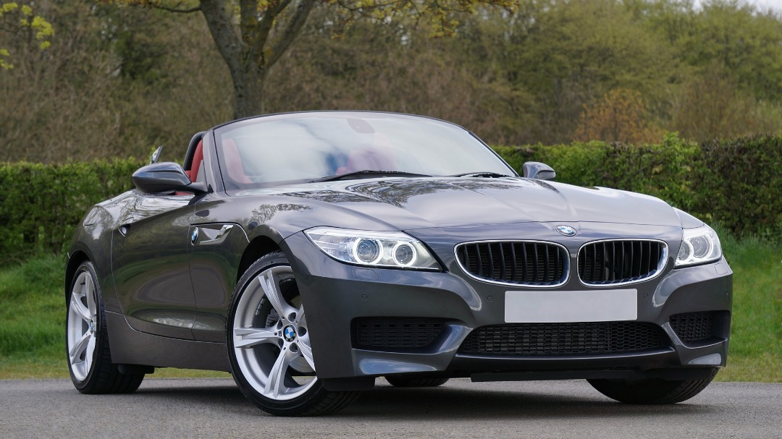


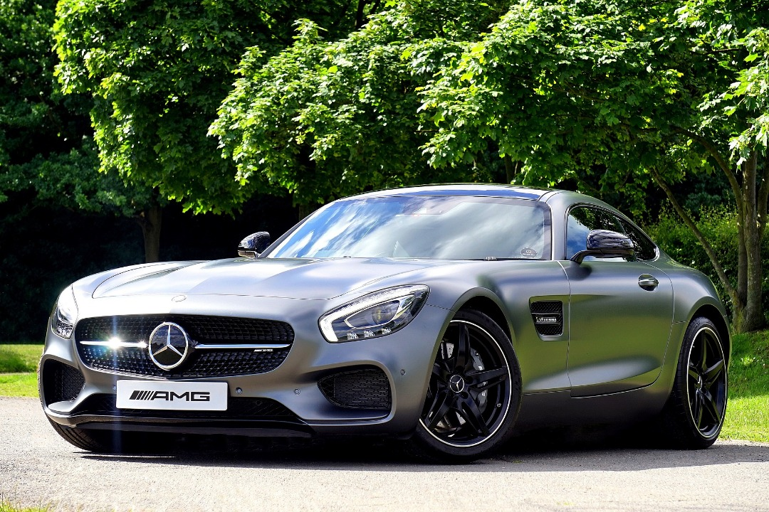

LUXURY CAR PROGRAMME
10
Hit the rank of DIAMOND and be eligible
to participate in this car partnership programme.
T & C Applies

Slide 76
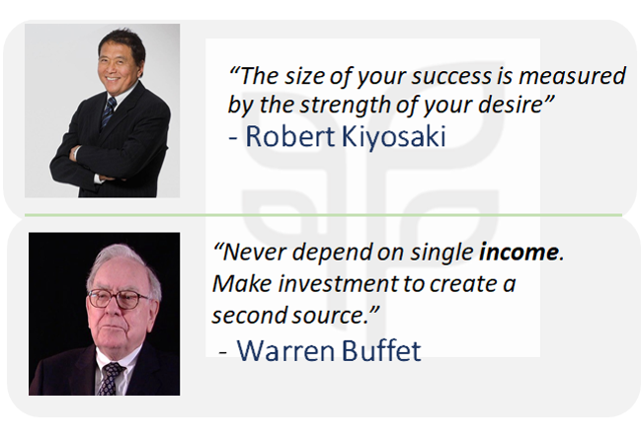
FINANCIAL TESTIMONIALS

Slide 77



